Slide 1



TO:MUM
THANK YOU FOR YOUR LOVE
FROM:SPRING

Slide 2


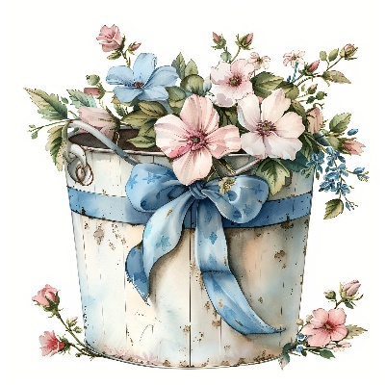

TO:DAD
THANK YOU FOR YOUR HELP

Slide 3

TO:TEACHERS
THANK YOU FOR YOUR CARE

