Slide 1
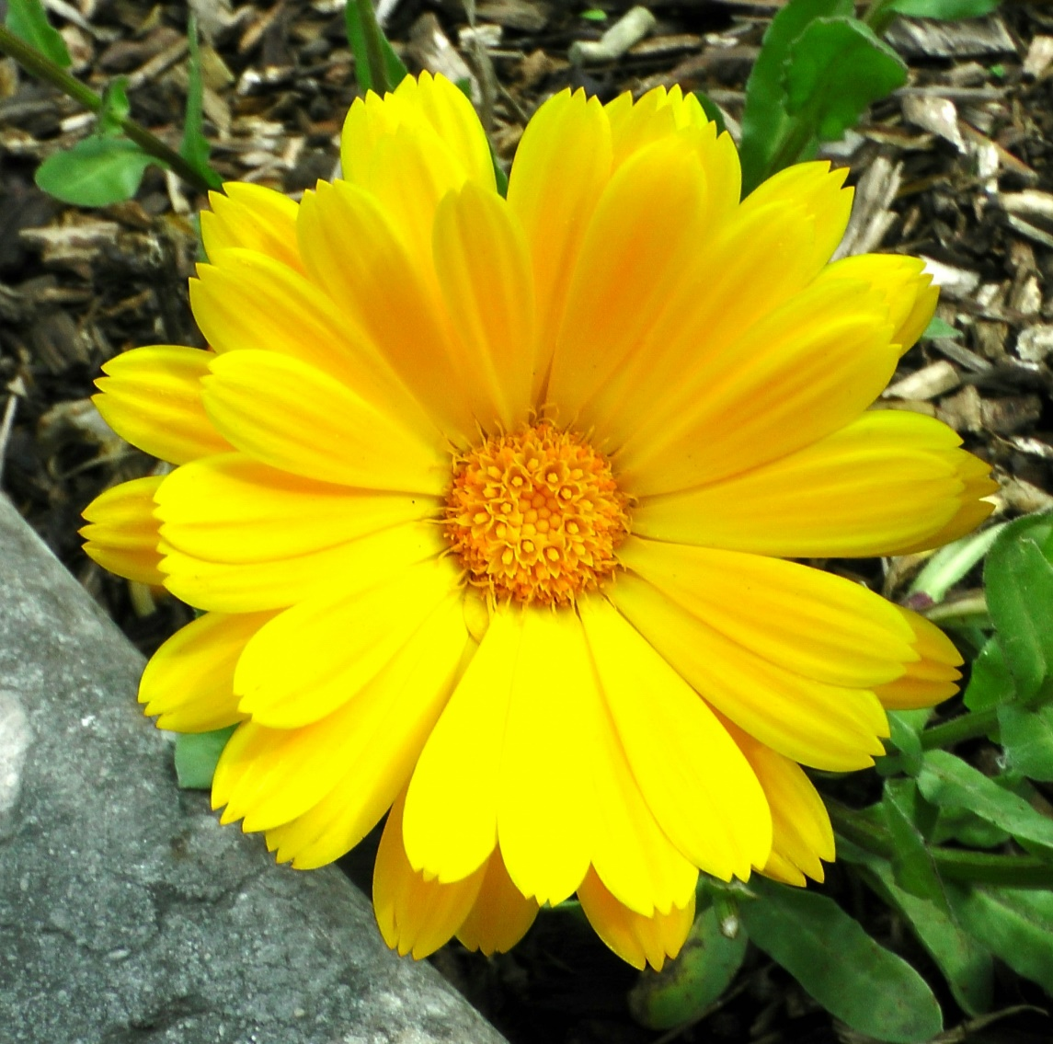
To :Mum
520
From:Philip

Slide 2
                Thank you for your care

Slide 3
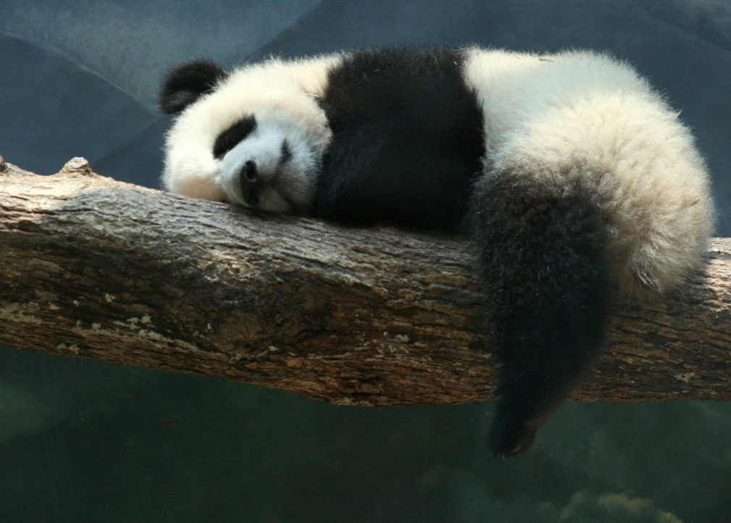
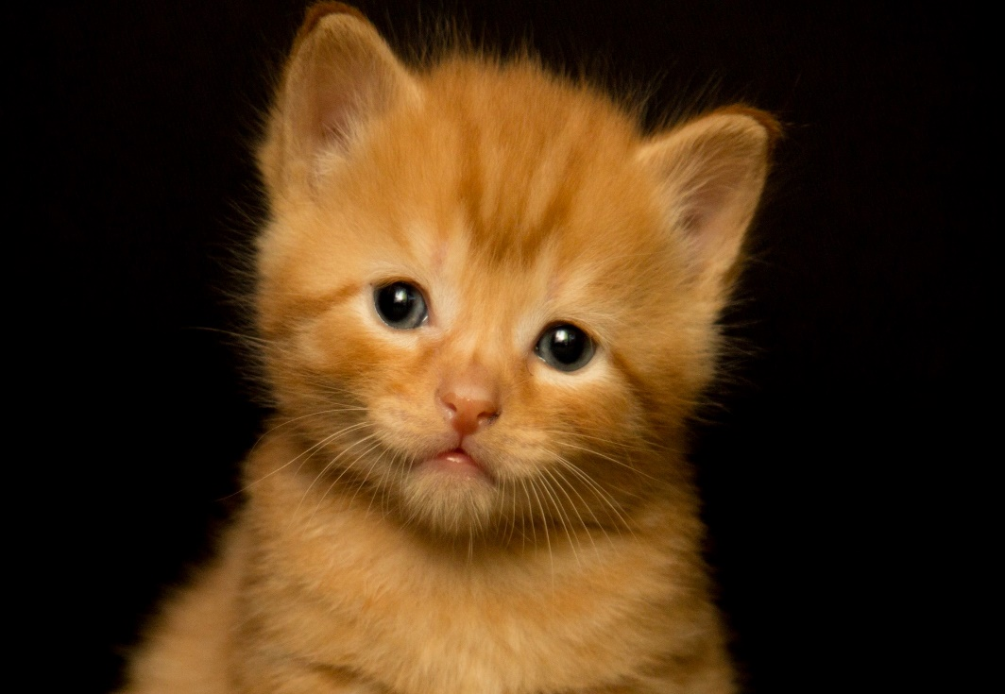

Slide 4
                Thank you for your love

